Slide 1
12: Query Processing

Slide 2
Basic Steps in Query Processing
1. Parsing and translation
2. Optimization
3. Evaluation
Notes:
The basic steps are:
1. Parsing and translation.
2. Optimization.
3. Evaluation
first action is to translate a given query into its internal form.
Parser check syntax of query, relation names.
System constructs a parse tree of query.
and Tree is translated into Algebraic expression.
If views are involved in query , they are replaced by base relations.
The relational-algebra representation of a query specifies only partially how to evaluate a query.
Each SQL query can itself be translated into a relational algebra expression in one of several ways.
Usually several ways to evaluate relational-algebra expressions. we can execute each relational-algebra operation by one of several
different algorithms.
To specify fully how to evaluate a query, we need not only to provide the
relational-algebra expression, but also to annotate it with instructions specifying
how to evaluate each operation (i.e. what algorithm to apply for the operation & also availability of index).
A relational algebra operation annotated with instructions on how to evaluate it is called an
evaluation primitive.
A sequence of primitive operations that can be used to evaluate a query is a query-execution plan or query-evaluation plan.
The query-execution engine takes a query-evaluation plan, executes that plan, and returns the answers to the query.

Slide 3
Basic Steps in Query Processing (Cont.)
Parsing and translation
Parser checks syntax, verifies relations.
The system constructs a parse-tree representation of the query,
translate the query into its internal form. This is then translated into relational algebra.
If the query was expressed in terms of a view, the translation phase also replaces all uses of the view by the relational-algebra expression.
Query Optimization
The different evaluation plans for a given query can have different costs. It is the responsibility of the system to construct a query evaluation plan that minimizes the cost of query evaluation; this task is called query optimization.
Evaluation
The query-execution engine takes a query-evaluation plan, executes that plan, and returns the answers to the query.

Slide 4
Basic Steps in Query Processing : Optimization
A relational algebra expression may have many equivalent expressions
E.g., σ_{salary<75000}(∏_{salary}(instructor)) is equivalent to ∏_{salary}(σ_{salary<75000}(instructor))
Each relational algebra operation can be evaluated using one of several different algorithms
Correspondingly, a relational-algebra expression can be evaluated in many ways.
Annotated expression specifying detailed evaluation strategy is called an evaluation-plan.
Annotations may state the algorithm to be used for a specific operation, or the particular index or indices to use.
An annotated instructions in a relational algebra is called an evaluation primitive.
A sequence of primitive operations that can be used to evaluate a query is a query-execution plan or query-evaluation plan.
Notes:
SELECT Salary FROM Instructor WHERE Salary>75000;

Slide 5
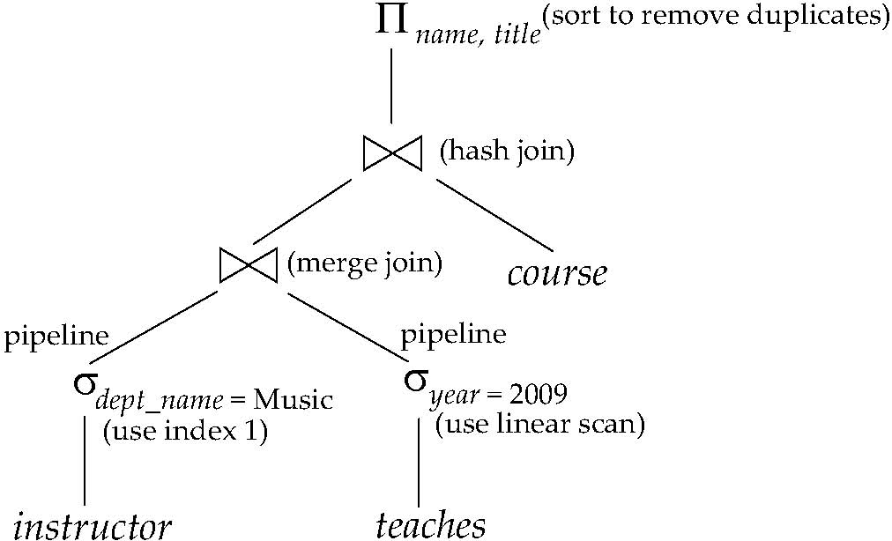
Evaluation Plan
E.g., We can use an index on salary to find instructors with salary < 75000,
or can perform complete relation scan and discard instructors with salary ≥ 75000
Annotated expression specifying detailed evaluation strategy is called an evaluation-plan

Slide 6
Basic Steps: Optimization (Cont.)
Query Optimization: Amongst all equivalent evaluation plans choose the one with lowest cost.
Cost is estimated using statistical information from the database catalog
e.g. number of tuples in each relation, size of tuples, etc.
In this chapter we study
How to measure query costs
Algorithms for evaluating relational algebra operations
How to combine algorithms for individual operations in order to evaluate a complete expression
Notes:
The different evaluation plans for a given query can have different costs.
We do not expect users to write their queries in a way that suggests the most efficient
evaluation plan.
Rather, it is the responsibility of the system to construct a query evaluation
plan that minimizes the cost of query evaluation; this task is called
query optimization.

Slide 7
Measures of Query Cost
Cost is generally measured as total elapsed time for answering query
Many factors contribute to time cost
disk accesses, CPU, or even network communication
Typically disk access is the predominant cost, and is also relatively easy to estimate. Measured by taking into account
Number of seeks * average-seek-cost
Number of blocks read * average-block-read-cost
Number of blocks written * average-block-write-cost
Cost to write a block is greater than cost to read a block
data is read back after being written to ensure that the write was successful
Notes:
To access (that is, to read or write) data on a given sector of
a disk, the arm first must move so that it is positioned over the correct track, and
then must wait for the sector to appear under it as the disk rotates. The time for
repositioning the arm is called the seek time, and it increases with the distance
that the arm must move. Typical seek times range from 2 to 30 milliseconds,
depending on how far the track is from the initial arm position. Smaller disks
tend to have lower seek times since the head has to travel a smaller distance.
The average seek time is the average of the seek times, measured over a
sequence of (uniformly distributed) random requests. If all tracks have the same
number of sectors, and we disregard the time required for the head to start
moving and to stop moving, we can show that the average seek time is one-third
the worst-case seek time. Taking these factors into account, the average seek time
is around one-half of the maximum seek time. Average seek times currently range
between 4 and 10 milliseconds, depending on the disk model.
Once the head has reached the desired track, the time spent waiting for the
sector to be accessed to appear under the head is called the rotational latency
time. Rotational speeds of disks today range from 5400 rotations per minute (90
rotations per second) up to 15,000 rotations per minute (250 rotations per second),
or, equivalently, 4 milliseconds to 11.1 milliseconds per rotation. On an average,
one-half of a rotation of the disk is required for the beginning of the desired sector
to appear under the head. Thus, the average latency time of the disk is one-half
the time for a full rotation of the disk.
The access time is then the sum of the seek time and the latency, and ranges
from 8 to 20milliseconds. Once the first sector of the data to be accessed has come
under the head, data transfer begins. The data-transfer rate is the rate at which data can be retrieved from or stored to the disk. Current disk systems support
maximum transfer rates of 25 to 100 megabytes per second; transfer rates are
significantly lower than the maximum transfer rates for inner tracks of the disk,
since they have fewer sectors. For example, a disk with a maximum transfer rate
of 100 megabytes per second may have a sustained transfer rate of around 30
megabytes per second on its inner tracks.
Requests for disk I/O are generated both by the file system and by the virtual
memory manager found in most operating systems. Each request specifies the
address on the disk to be referenced; that address is in the form of a block number.
A block is a logical unit consisting of a fixed number of contiguous sectors. Block
sizes range from 512 bytes to several kilobytes. Data are transferred between disk
and main memory in units of blocks. The term page is often used to refer to
blocks, although in a few contexts (such as flash memory) they refer to different
things.

Slide 8
Measures of Query Cost (Cont.)
For simplicity we just use the number of block transfers from disk and the number of seeks as the cost measures
t_{T} – time to transfer one block
t_{S} – time for one seek
We want to transfer b blocks of data and assume we require S seeks to transfer b blocks of data..
Cost for b block transfers plus S seeks
We ignore CPU costs for simplicity
Real systems do take CPU cost into account
We do not include cost to writing output to disk in our cost formulae
=b * t_{T} + S * t_{S}
Notes:
In order to optimize a query, a query optimizer must know the cost of each
operation. Although the exact cost is hard to compute, since it depends on many
parameters such as actual memory available to the operation, it is possible to get
a rough estimate of execution cost for each operation.
We use the number of block transfers from disk and the number of disk seeks
to estimate the cost of a query-evaluation plan. If the disk subsystem takes an
average of t_{T} seconds to transfer a block of data, and has an average block-access
time (disk seek time plus rotational latency) of t_{S} seconds, then an operation that
transfers b blocks and performs S seeks would take b ∗ t_{T} + S ∗ t_{S} seconds. The
values of t_{T} and t_{S} must be calibrated for the disk system used, but typical values
for high-end disks today would be t_{S} = 4 milliseconds and t_{T} = 0.1 milliseconds,
assuming a 4-kilobyte block size and a transfer rate of 40 megabytes per second.

Slide 9
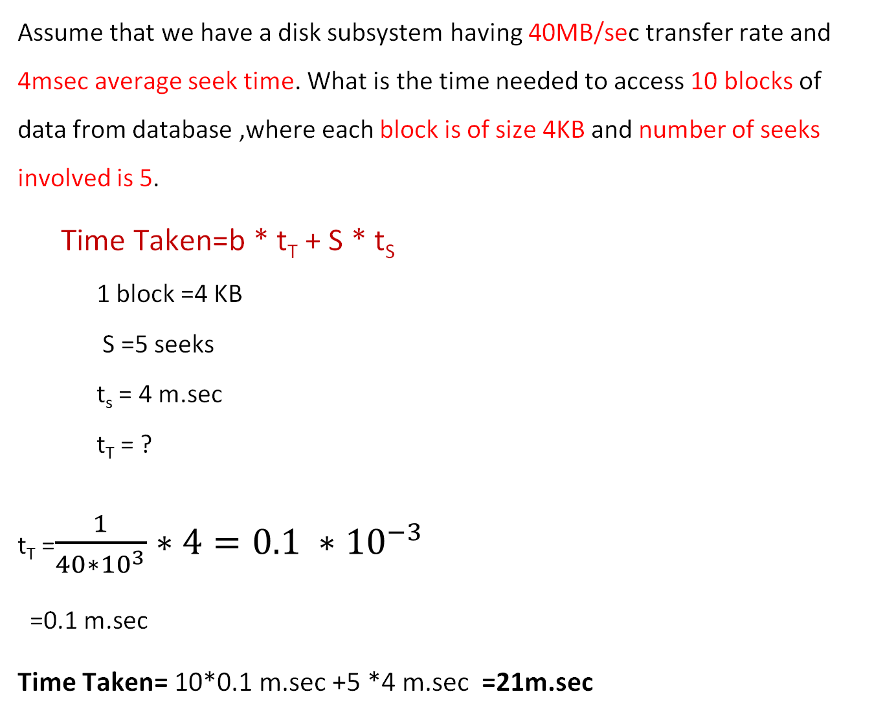
Assume that we have a disk subsystem having 40MB/sec transfer rate and 4msec average seek time. What is the time needed to access 10 blocks of data from database ,where each block is of size 4KB and number of seeks involved is 5.
Time Taken=b * t_{T} + S * t_{S}
1 block =4 KB
S =5 seeks
t_{s} = 4 m.sec
t_{T} = ?
t_{T} =$\frac{1}{40∗{10}^{3}}∗4=0.1 ∗{10}^{−3}$
=0.1 m.sec
Time Taken= 10*0.1 m.sec +5 *4 m.sec =21m.sec

Slide 10
Measures of Query Cost (Cont.)
Several algorithms can reduce disk IO by using extra buffer space
Amount of real memory available to buffer depends on other concurrent queries and OS processes, known only during execution
We often use worst case estimates, assuming only the minimum amount of memory needed for the operation is available
In Best case, Required data may be buffer resident already, avoiding disk I/O.
But hard to take into account for cost estimation
Notes:
10

Slide 11
Selection Operation
File scan
Algorithm A1 (linear search). Scan each file block and test all records to see whether they satisfy the selection condition.
b_{r} denotes number of blocks containing records from relation r
If selection is on a key attribute, can stop on finding record
(Because -at most 1 record satisfies the search criteria)
Note: binary search generally does not make sense since data is not stored consecutively
except when there is an index available,
and binary search requires more seeks than index search
Cost estimate = b_{r} block transfers *t_{T} + 1* t_{s}
cost = (b_{r} /2) block transfers *t_{T} + 1* t_{s}
Notes:
Cost estimate =One initial seek plus br block transfers,
where br denotes the number of blocks in the file.
A1 (linear search). In a linear search, the system scans each file block and
tests all records to see whether they satisfy the selection condition. An initial
seek is required to access the first block of the file. In case blocks of the file
are not stored contiguously, extra seeks may be required, but we ignore this
effect for simplicity.

Slide 12
Selections Using Indices
Index scan – search algorithms that use an index
selection condition must be on search-key of index.
A2 (primary index, equality on key). Retrieve a single record that satisfies the corresponding equality condition
Cost = h_{i} *(t_{T} + t_{S})+ 1*(t_{T} + t_{S})
A3 (primary index, equality on nonkey) Retrieve multiple records.
Records will be on consecutive blocks
Let b = number of blocks containing matching records
Cost= (h_{i} + 1) * (t_{T} + t_{S})
Cost = h_{i} * (t_{T} + t_{S}) + t_{S} + t_{T} * b
Notes:
A primary index is an index that allows the records of a file to be read
in an order that corresponds to the physical order in the file. An index that is not a
primary index is called a secondary index.
Search algorithms that use an index are referred to as index scans.

Slide 13
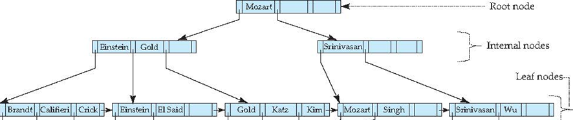
A2: Primary index on Name
Cost= (h_{i} + 1) * (t_{T} + t_{S})
h_{i}
Let us assume Name is unique i.e. is key , primary index is created on Name.
Assume the query – Select * From Instructor Where Name=‘Gold’
Notes:
Primary index on Name h_{i}
Let us assume Name is unique i.e. is key , primary index is created on Name.
Assume the query – Select * From Instructor Where Name=‘Gold’

Slide 14
Blocks Required
n_{r}: number of tuples in a relation r.
b_{r}: number of blocks containing tuples of r.
l_{r}: size of a tuple of r.
f_{r}: blocking factor of r — i.e., the number of tuples of r that fit into one block.
If tuples of r are stored together physically in a file, then:
If n_{r} =100 and f_{r}=5 , then number of blocks required
b_{r}=100/5 = upper_bound (20)=20 blocks are required to store 100 tuples.
Assume f_{r}=7 b_{r}=100/7 =upper_bound (14.23) =15 blocks are required
Notes:
If nr =100 and fr=5 , then number of blocks required br=100/5 =20 blocks are required to store 100 tuples.

Slide 15
Join Operation
Several different algorithms to implement joins
Nested-loop join
Block nested-loop join
Indexed nested-loop join
Merge-join
Hash-join
Choice based on cost estimate
Examples use the following information student takes
Number of records of student: n_{r}= 5,000 (1 block fits 50 record)
takes: n_{s}= 10,000 (1 block fits 25 records)
Number of blocks of student: b_{r}= 100
takes: b_{s}=400
Notes:
We assume the
following information about the two relations:
• Number of records of student: nstudent = 5, 000.
• Number of blocks of student: bstudent = 100.
• Number of records of takes: ntakes = 10, 000.
• Number of blocks of takes: btakes = 400.

Slide 16
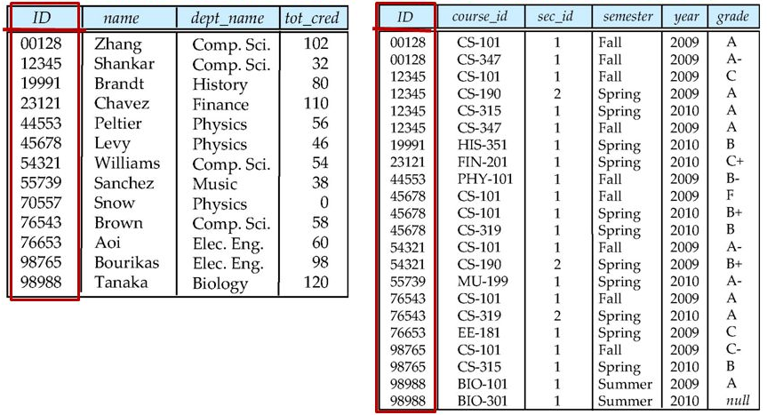
Student
takes

Slide 17
Nested-Loop Join
To compute the theta join r _{θ} s
For each record in r, we have to perform complete scan on s. pairs of tuples to be considered is n_{r} ∗ n_{s}, where n_{r} denotes the
number of tuples in r, and n_{s} denotes the number of tuples in s.
for each tuple t_{r} in r do begin for each tuple t_{s} in s do begin test pair (t_{r} , t_{s}) to see if they satisfy the join condition θ if they do, add t_{r} t_{s} to the result. end end
r is called the outer relation and s the inner relation of the join.
Requires no indices and can be used with any kind of join condition.
Expensive since it examines every pair of tuples in the two relations.
Notes:
Read a Block B_{i} from r (and take 1st record in the block r_{i}) , then read 1 block at time, all the blocks in s and when every block read from s (take record s₁ check r_{i} can be joined with s₁, read s₂ again check r_{i} join to s₂ and so on till last record in s). Repeat the whole thing for next record r_{i+1} in the block B_{i.}
The whole thing is repeated for every block in the r.

Slide 18
Nested-Loop Join (Cont.)
In the worst case, if there is enough memory only to hold one block of each relation, the estimated cost is n_{r} ∗ b_{s} + b_{r} block transfers, and n_{r} + b_{r} seeks*
n_{r} seeks on S and b_{r} seeks on R
Example: Assuming worst case memory availability cost estimate is
with student as outer relation: ( student has 100 blocks, smaller relation than takes, hence costlier)
5000 ∗ 400 + 100 = 2,000,100 block transfers,
5000 + 100 = 5100 seeks,
assuming seek time t_{S} = 4 milliseconds and transfer time t_{T} = 0.1 milliseconds.
4 msec *5100 seeks +0.1 msec * 2,000,100
= 2,20,410 msec
records of student: n_{r}= 5,000
takes: n_{s}= 10,000
blocks of student: b_{r}= 100
takes: b_{s}=400
Notes:
r/w head move to 1st block of r( 1 seek ), next r/w moves to 1st block of s ( 1 seek ) and sequentially each record in s is accessed ,so no seek only block transfer. All records in s are accessed and add t_{r} • t_{s} to result if θ is satisfied.
Previously r/w head was at the end of s ,so r/w head move to 2nd block of r ( 1 more seek ), next r/w moves to 1st block of s ( 1 seek ) and sequentially each record in s is accessed ,so no seek only block transfer. All records in s are accessed and add t_{r} • t_{s} to result if θ is satisfied.
This repeats , hence if there are b_{r} blocks in r, then b_{r} seeks required.
1 seek is required for beginning the scan of s. if there are n_{r} records are there in r then n_{r} times s is scanned, so n_{r} seeks are required.
Total seeks =b_{r} + n_{r}
Number of records of student: n_{r}= 5,000 takes: n_{s}= 10,000
Number of blocks of student: b_{r}= 100 takes: b_{s}=400
student as outer relation
Time= 5000*4msec +2000100*0.1 msec = 220010 msec
takes as the outer relation
Time= 10400*4 msec + 1000400*0.1 msec = 141540 msec

Slide 19
Nested-Loop Join (Cont.)
records of student: n_{r}= 5,000
takes: n_{s}= 10,000
blocks of student: b_{r}= 100
takes: b_{s}=400
Example : Considering takes as the outer relation ( takes has 400 blocks, bigger relation than student, The number of block transfers is significantly less, and although the number of seeks is higher, the overall cost is reduced, assuming seek time t_{S} = 4 milliseconds and transfer time t_{T} = 0.1 milliseconds. hence costlier)
10000 ∗ 100 + 400 = 1,000,400 block transfers and 10,400 seeks
4msec*10400 seek+0.1msec*1000400
41,600+100040 = 1,41,640msec
Notes:
r/w head move to 1st block of r( 1 seek ), next r/w moves to 1st block of s ( 1 seek ) and sequentially each record in s is accessed ,so no seek only block transfer. All records in s are accessed and add t_{r} • t_{s} to result if θ is satisfied.
Previously r/w head was at the end of s ,so r/w head move to 2nd block of r ( 1 more seek ), next r/w moves to 1st block of s ( 1 seek ) and sequentially each record in s is accessed ,so no seek only block transfer. All records in s are accessed and add t_{r} • t_{s} to result if θ is satisfied.
This repeats , hence if there are b_{r} blocks in r, then b_{r} seeks required.
1 seek is required for beginning the scan of s. if there are n_{r} records are there in r then n_{r} times s is scanned, so n_{r} seeks are required.
Total seeks =b_{r} + n_{r}
Number of records of student: n_{r}= 5,000 takes: n_{s}= 10,000
Number of blocks of student: b_{r}= 100 takes: b_{s}=400
student as outer relation
Time= 5000*4msec +2000100*0.1 msec = 220010 msec
takes as the outer relation
Time= 10400*4 msec + 1000400*0.1 msec = 141540 msec

Slide 20
Nested-Loop Join (Cont.)
In the worst case, if there is enough memory only to hold one block of each relation, the estimated cost is - n_{r} ∗ b_{s} + b_{r} block transfers, and n_{r} + b_{r} seeks*
If the any one relation fits entirely in memory, use that as the inner relation.
Reduces cost to b_{r} + b_{s} block transfers and 2 seeks ( how? left to students)
If smaller relation (student) fits entirely in memory, the cost estimate will be 500 block transfers.
Block nested-loops algorithm (next slide) is preferable.
* See notes section.
Notes:
r/w head move to 1st block of r( 1 seek ), next r/w moves to 1st block of s ( 1 seek ) and sequentially each record in s is accessed ,so no seek only block transfer. All records in s are accessed and add t_{r} • t_{s} to result if θ is satisfied.
Previously r/w head was at the end of s ,so r/w head move to 2nd block of r ( 1 more seek ), next r/w moves to 1st block of s ( 1 seek ) and sequentially each record in s is accessed ,so no seek only block transfer. All records in s are accessed and add t_{r} • t_{s} to result if θ is satisfied.
This repeats , hence if there are b_{r} blocks in r, then b_{r} seeks required.
1 seek is required for beginning the scan of s. if there are n_{r} records are there in r then n_{r} times s is scanned, so n_{r} seeks are required.
Total seeks =b_{r} + n_{r}
Number of records of student: n_{r}= 5,000 takes: n_{s}= 10,000
Number of blocks of student: b_{r}= 100 takes: b_{s}=400

Slide 21
Block Nested-Loop Join
Variant of nested-loop join in which every block of inner relation is paired with every block of outer relation.
for each block B_{r} of r do begin for each block B_{s} of s do begin for each tuple t_{r} in B_{r} do begin for each tuple t_{s} in B_{s} do begin Check if (t_{r} , t_{s}) satisfy the join condition if they do, add t_{r} t_{s} to the result. end end end end

Slide 22
Block Nested-Loop Join (Cont.)
Worst case estimate: b_{r} ∗ b_{s} + b_{r} block transfers and 2 * b_{r} seeks
Each block in the inner relation s is read once for each block in the outer relation.
Best case: If the smaller relation fits entirely in memory
b_{r} + b_{s} block transfers & 2 seeks.

Slide 23
Example of Block Nested-Loop Join Costs
Compute student takes, with student as the outer relation.
Number of records of student: n_{student} =n_{r}= 5, 000.
Number of blocks of student: b_{student} = b_{r}=100.
Number of records of takes: n_{takes} =n_{s}= 10, 000.
Number of blocks of takes: b_{takes} = b_{s} =400.
Cost of block nested loops join
cost =b_{r} ∗ b_{s} + b_{r} block transfers and 2 * b_{r} seeks
400*100 + 100 = 40,100 block transfers and
2 * 100 = 200 seeks
assuming worst case memory
may be significantly less with more memory
Notes:
• Number of records of student: n_{student} =n_{r}= 5, 000.
• Number of blocks of student: b_{student} = b_{r}=100.
• Number of records of takes: n_{takes} =n_{s}= 10, 000.
• Number of blocks of takes: b_{takes} = b_{s} =400.

Slide 24
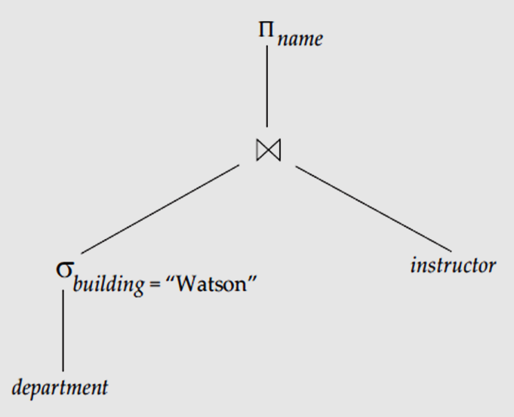
Evaluation of Expressions
So far: we have seen algorithms for individual operations
Alternatives for evaluating an entire expression tree
Materialization: generate results of an expression whose inputs are relations or are already computed, materialize (store) it on disk. Repeat.
Pipelining: pass on tuples to parent operations even as an operation is being executed
We study above alternatives in more detail

Slide 25
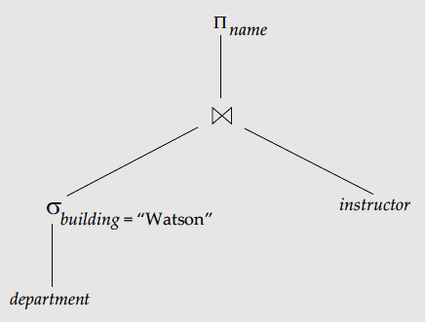
Materialization
Materialized evaluation: evaluate one operation at a time, starting at the lowest-level. Use intermediate results materialized into temporary relations to evaluate next-level operations.
Consider the example-
Πname(σ _{building =“Watson”}(department) ⋈ instructor)
in figure below, compute and store
Then above computed(materialized) stored
Result is joined with instructor, and
finally compute the projection on name.
Notes:
Evaluation described is called materialized evaluation, since the results
of each intermediate operation are created (materialized) and then are used
for evaluation of the next-level operations.

Slide 26
Materialization (Cont.)
Materialized evaluation is always applicable
Cost of writing results to disk and reading them back can be quite high.
Our cost formulas for operations ignore cost of writing results to disk, so
Overall cost = Sum of costs of individual operations + cost of writing intermediate results to disk
Double buffering: use two output buffers for each operation, when one is full write it to disk while the other is continuing execution getting filled by executing algorithm.
Allows overlap of disk writes with computation and reduces execution time
Notes:
Double buffering (using two buffers, with one continuing execution of the
algorithm while the other is being written out) allows the algorithm to execute
more quickly by performing CPU activity in parallel with I/O activity. The number
of seeks can be reduced by allocating extra blocks to the output buffer, and writing
out multiple blocks at once.

Slide 27
Pipelining
Pipelined evaluation : evaluate several operations simultaneously, passing the results of one operation on to the next.
Πname(σ _{building =“Watson”}(department) ⋈ instructor)
In previous expression tree, don’t store result of
instead, pass tuples directly to the join
Similarly, don’t store result of join,
pass tuples directly to projection.

Slide 28
Pipelining
Two benefits
It eliminates the cost of reading and writing temporary relations, reducing the cost of query evaluation
It can start generating query results quickly, if the root operator of a query evaluation plan is combined in a pipeline with its inputs.
Pipelining may not always be possible – e.g., sort, hash-join.
For pipelining to be effective, use evaluation algorithms that generate output tuples even as tuples are received for inputs to the operation.
Pipelines can be executed in two ways: demand driven and producer driven

Slide 29
Pipelining (Cont.)
In demand driven or lazy evaluation (Pull)
Each operation requests next tuple from children operations as required, in order to output its next tuple
In between calls, operation has to maintain “state” so it knows what to return next
In producer-driven or eager pipelining (Push)
Operators produce tuples eagerly and pass them up to their parents
Buffer maintained between operators, child puts tuples in buffer, parent removes tuples from buffer
if buffer is full, child waits till there is space in the buffer, and then generates more tuples
System schedules operations that have space in output buffer and can process more input tuples
Alternative name: pull and push models of pipelining

Slide 30
Additional Optimization Techniques
Materialized Views

Slide 31
Materialized Views
A materialized view is a view whose contents are computed and stored.
Consider the view create view department_total_salary(dept_name, total_salary) as select dept_name, sum(salary) from instructor group by dept_name
Materializing the above view would be very useful if the total salary by department is required frequently
Saves the effort of finding multiple tuples and adding up their amounts.
An option for maintaining materialized views is to define triggers on insert, delete, and update of each relation in the view definition. Simplest is completely recompute the materializedview on every update.
Notes:
Another option for maintaining materialized views is to define triggers on insert,
delete, and update of each relation in the view definition. The triggers must modify
the contents of the materialized view, to take into account the change that caused the
trigger to fire. A simplistic way of doing so is to completely recompute the materialized
view on every update.
A better option is to modify only the affected parts of the materialized view, which
is known as incremental view maintenance.

Slide 32
Materialized View Maintenance
The task of keeping a materialized view up-to-date with the underlying data is known as materialized view maintenance
Materialized views can be maintained by re-computation on every update
A better option is to use incremental view maintenance
modify only the affected parts of the materialized view.
which is known as incremental view maintenance View maintenance can be done by-
Immediate view maintenance
Manually defining triggers on insert, delete, and update of each relation in the view definition
Manually written code to update the view whenever database relations are updated. Modern databases provide support to declare view as “Materialized”. No need of trigger.
Deferred view maintenance
Periodic re-computation (e.g. nightly)
view maintenance is deferred to a later time.
Notes:
https://oracle-base.com/articles/misc/materialized-views
https://www.complexsql.com/materialized-view/
-- Normal
CREATE MATERIALIZED VIEW view-name
BUILD [IMMEDIATE | DEFERRED]
REFRESH [FAST | COMPLETE | FORCE ]
ON [COMMIT | DEMAND ]
[[ENABLE | DISABLE] QUERY REWRITE]
AS
SELECT ...;

Slide 33
Incremental View Maintenance
The changes (inserts and deletes) to a relation or expressions are referred to as its differential
Set of tuples inserted to and deleted from r are denoted i_{r} and d_{r}
To simplify our description, we only consider inserts and deletes
We replace updates to a tuple by deletion of the tuple followed by insertion of the update tuple
We describe how to compute the change to the result of each relational operation, given changes to its inputs
We then outline how to handle relational algebra expressions

Slide 34
Join Operation
How to do maintenance of materialized view created by JOIN.
Consider the materialized view v = r s and an update to r
Let r^{old} and r^{new} denote the old and new states of relation r
Consider the case of an insert i_{r} tuples to r:
We can write r^{new} s as (r^{old} ∪ i_{r}) s
And rewrite the above to (r^{old} s) ∪ (i_{r} s)
But (r^{old} s) is simply the old value of the materialized view, so the incremental change to the view is just i_{r} s
Thus, for inserts v^{new} = v^{old} ∪(i_{r} s)
Similarly for deletes v^{new} = v^{old} – (d_{r} s)
s
r_{old}
A, 1, p
B, 2, r
B, 2, s
r_{old} s = V_{old}
A, 1
B, 2
1, p
2, r
2, s
C,2
V_{new}
₌
v^{old} ∪(i_{r} s)
i_{r}
C, 2, r
C, 2, s
I_{r} s

Slide 35
END

Slide 36
End of Chapter

